Slide 1
Dr. Sunirmal Khatua
Cloud Economics and Billing
By
Visvesvaraya Young Faculty Fellow, Govt. of India
Assistant Professor, University of Calcutta
Notes:
We celebrate Christmas to remember the birth of Jesus Christ

Slide 2
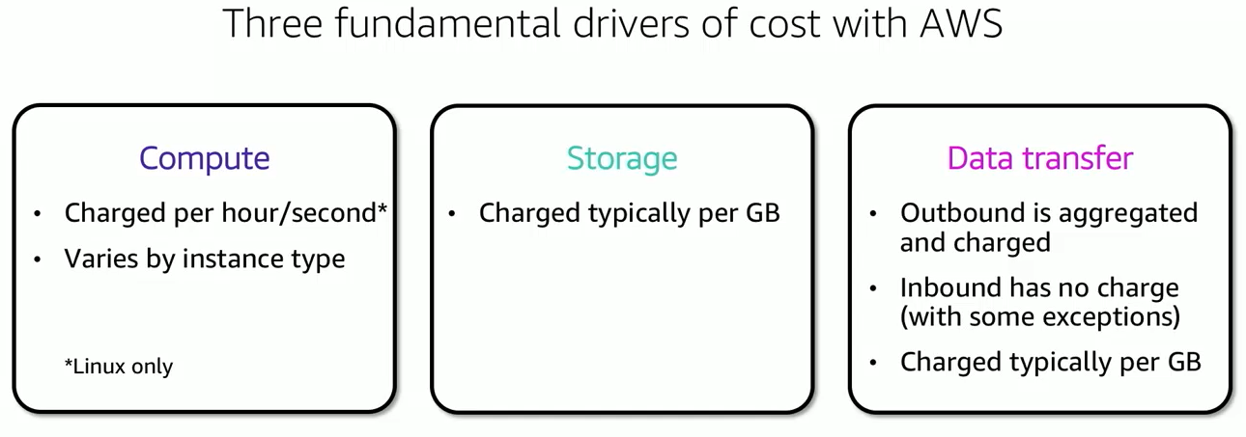
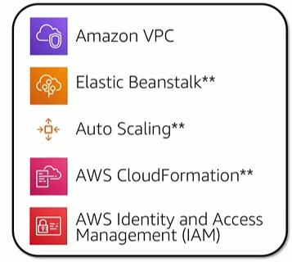
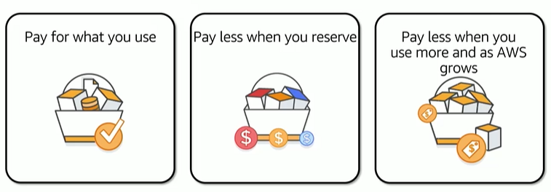
AWS Pricing Model
AWS Services with No Charges
All Upfront Reserve Instances (AURI)
Economics for Scale
Partial Upfront Reserve Instances (PURI)
No Upfront Reserve Instances (NURI)

Slide 3
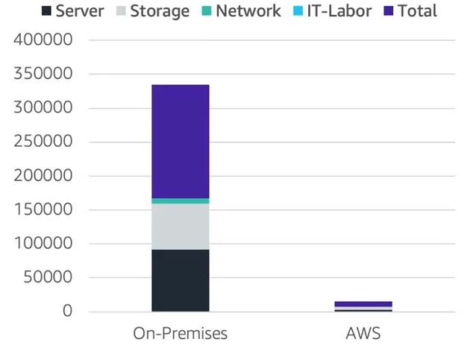
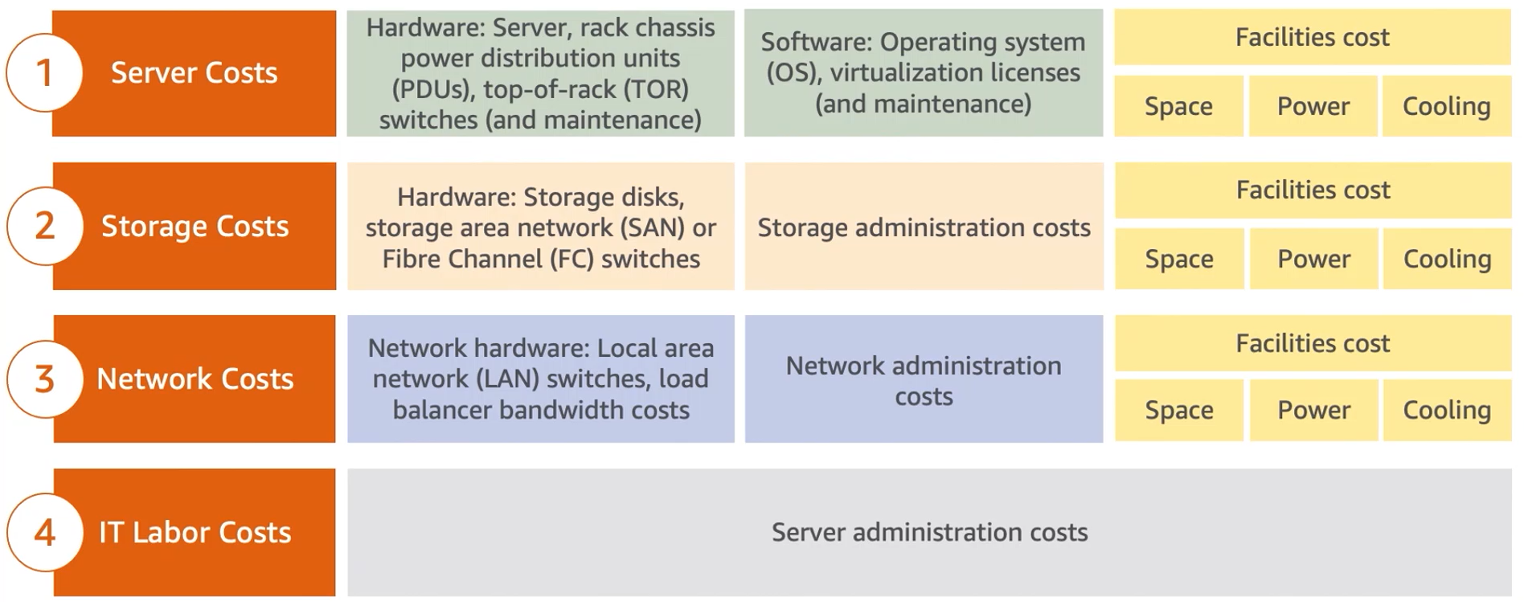
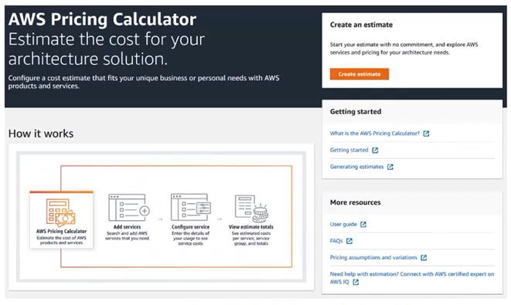
Total Cost of Ownership(TCO)

Slide 4
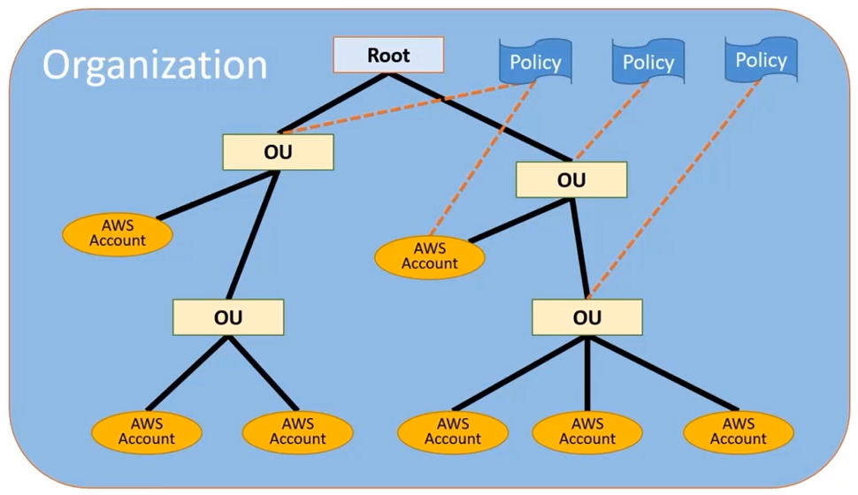
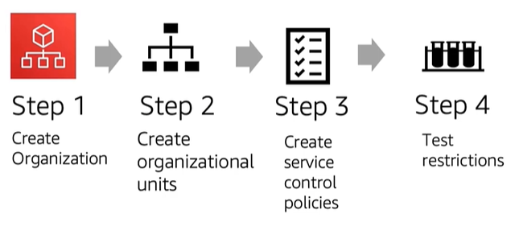
AWS Organizations
Service Control Policies (SCP) enables you to allow/deny access to
AWS Services for individual account or a group of accounts (OU)

Slide 5
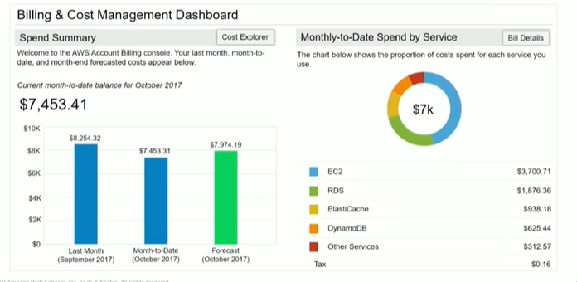
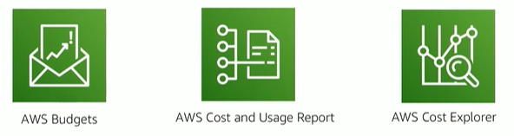
AWS Billing
AWS Budget : Set custom budgets that alert you when you exceed your budgeted thresholds
AWS Cost and Usage Report : Provides access to detailed data, enabling you to better analyze and understand
your AWS costs as well as your available offer. (Fine grain details)
AWS Cost Explorer : Visualization tool for quickly analyzing, filtering, and forecasting up to 13 months of cost data.

Slide 6
AWS Support Plans
AWS Support offers four support plans:
Basic Support : Resource Center access, Service Health Dashboard, product FAQ, discussion forum.
2. Developer Support : Support for early development on AWS
3. Business Support : Customers that run production workload
4. Enterprise Support : Customers that run business and mission0critical Workloads

